Slide 1

Talk is Not Cheap:
Oral Exams in the Presence of AI
Jacqueline Herman (Northern Kentucky University) & Justin Post (North Carolina State University)

Slide 2

Oral Exams: Polling the Room
https://app.wooclap.com/RMREUPE?from=instruction-slide

Slide 3

Our Motivations
Ensure academic integrity in the age of AI.
Assess students’ conceptual understanding through verbal reasoning.
Notes:
Jackie: I would mention being an alternative to take-home exams with the academic integrity bullet, but was unsure if replacing take-home exams was part of your motivation at also. Justin: I did in the programming course because we didn’t trust what they were turning in as their work. So it was a way to do that which wasn’t just a multiple choice types quiz..
Jackie: I think we will also want to mention that these did not replace in-class exams.
Justin; Agreed!
I think maybe we could split this into 2 or 4 slides and add a graphic or something to make it a bit more interesting looking.

Slide 4

Our Motivations
Provide an alternative way for students to demonstrate understanding, especially for those who may struggle with traditional in-class exams.
Build stronger student-instructor interactions.
Notes:
Jackie: I would mention being an alternative to take-home exams with the academic integrity bullet, but was unsure if replacing take-home exams was part of your motivation at also. Justin: I did in the programming course because we didn’t trust what they were turning in as their work. So it was a way to do that which wasn’t just a multiple choice types quiz..
Jackie: I think we will also want to mention that these did not replace in-class exams.
Justin; Agreed!
I think maybe we could split this into 2 or 4 slides and add a graphic or something to make it a bit more interesting looking.

Slide 5
Our Experiences (Set-Up)
Undergraduate statistics theory class @ NKU.
Format 1: “Take-home” with encouraged collaboration.
Given a week in advance (5 questions), schedule a 20-minute meeting with me outside of class
The student chose one question, and I chose one question
Format 2: Minimal preparation with individualized questions.
Given 45 minutes outside my office to work on two problems
30-minute oral exam immediately after.
Notes:
Here, we could pull up an example of each “test”, as well as how we evaluated the students
Agreed!

Slide 6
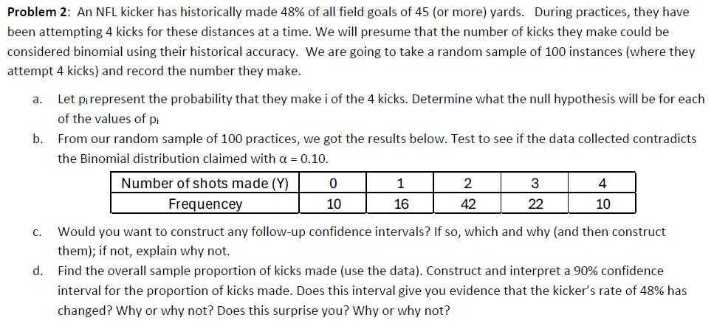
Example Questions

Slide 7
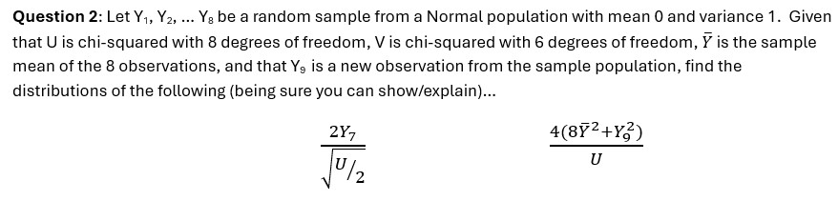
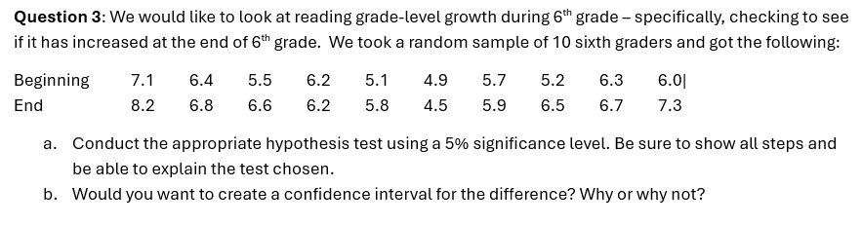
Example Questions

Slide 8
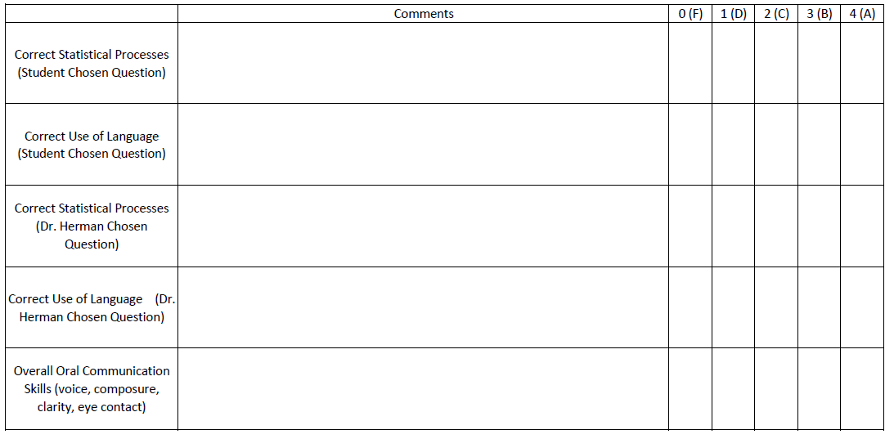
Rubric

Slide 9
Our Experiences (Set-Up)
Online Master’s level statistics theory class @ NCSU.
Exam week: Oral exam window M-W, Written window Th-F
Preparation:
Video submission questions on each homework
Emphasis on why/purpose during lecture
Exam content:
Two shorter questions and three longer questions

Slide 10
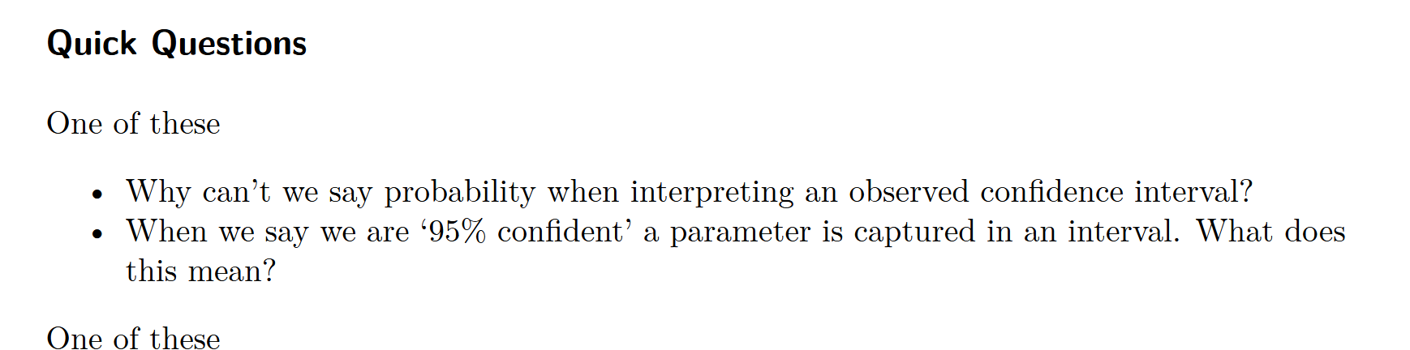
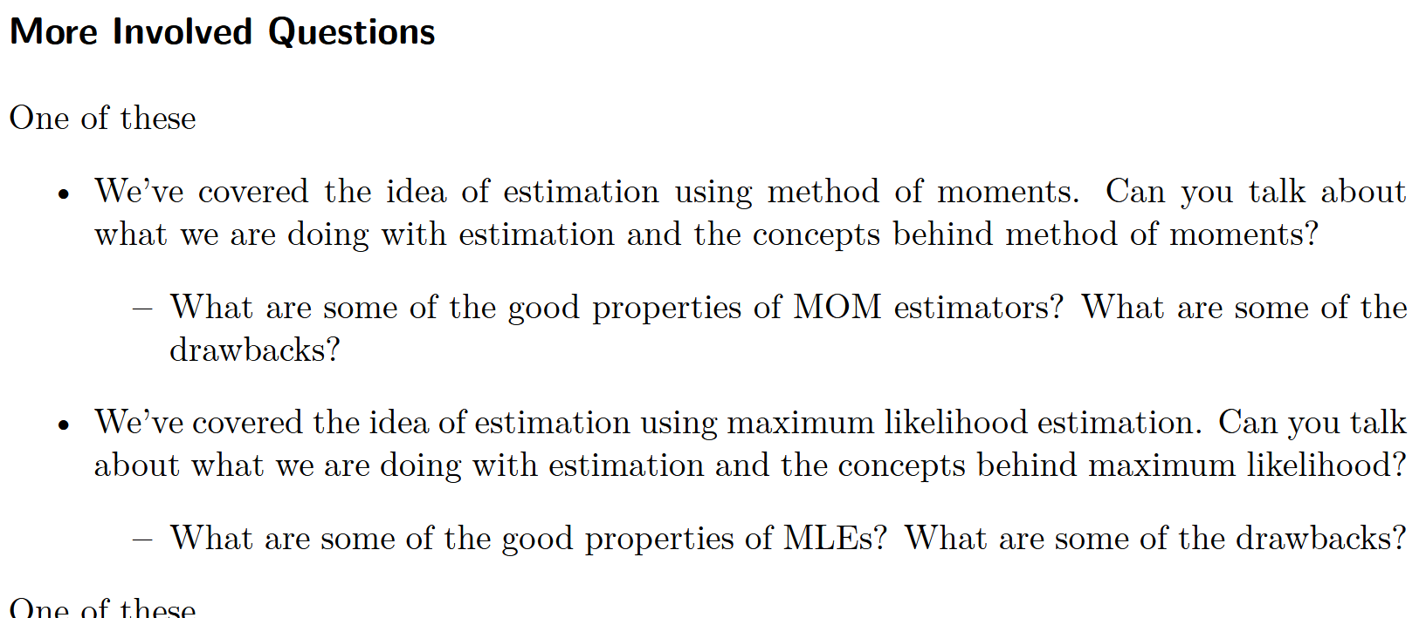
Example Questions

Slide 11
Our Experiences (Set-Up)
Undergraduate introductory R & SAS coding classes @ NCSU.
Flipped 1 credit courses
Two weeks set aside for oral exams
Preparation:
Example program and rubric given for studying
Exam content:
Two basic recall questions and two conceptual ‘purpose’ questions
Notes:
Here, we could pull up an example of each “test”, as well as how we evaluated the students

Slide 12
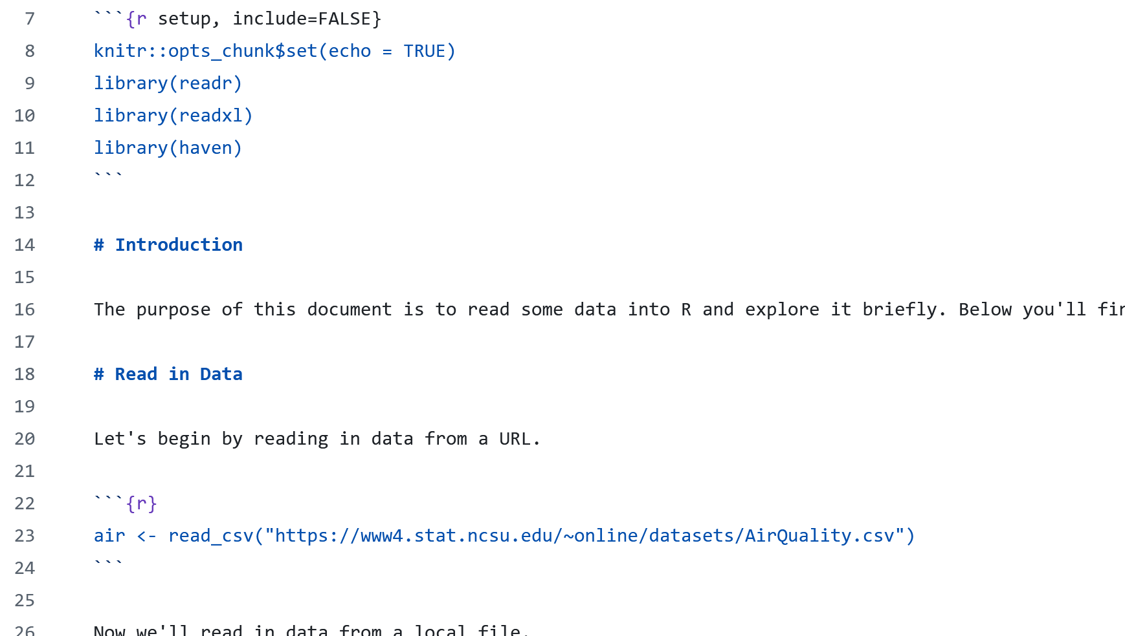
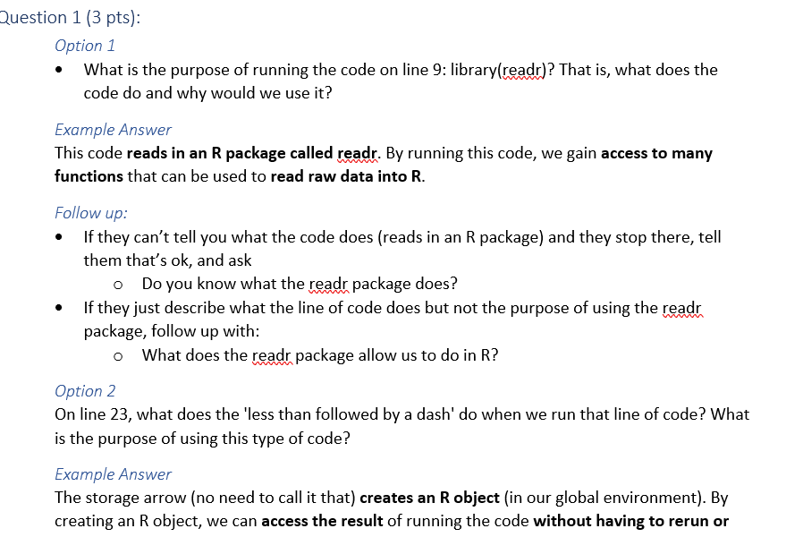
Example Program and Questions

Slide 13
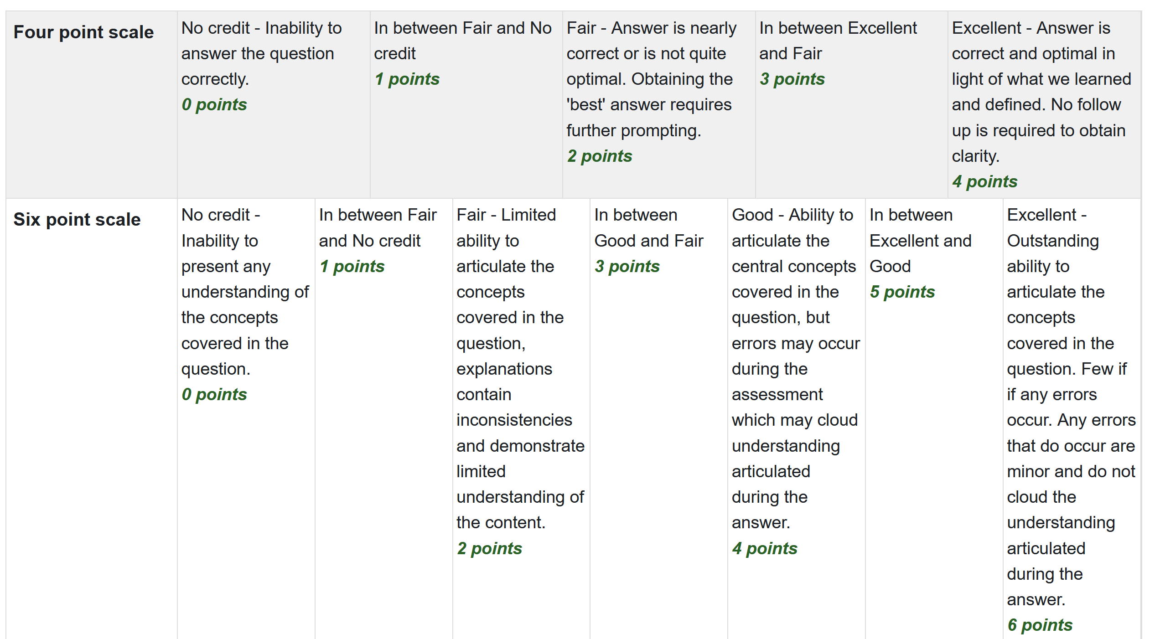
Rubric

Slide 14
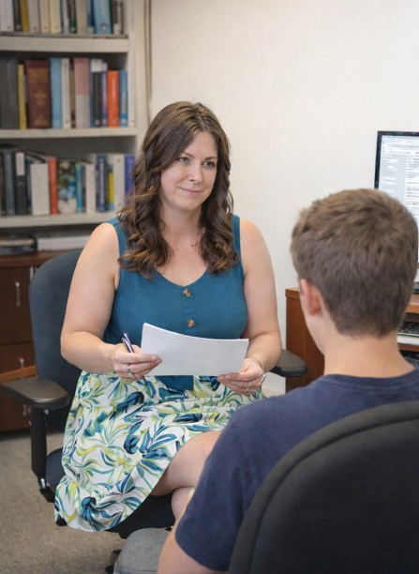
Our Experiences (During)
Creating oral exam questions.
Developing consistency in initial and follow-up questions.
Example situations/surprises
Informal Student Feedback
Notes:
Other bullets I’m not thinking about?

Slide 15
Our Thoughts Moving Forward
Is there an order effect?
Subjectivity of rubric grading.
Ability to record the exams (what if there is a dispute?)
Would we keep doing them?
Any adjustments or changes we would consider?
Notes:
Maybe switch the order of these two groupings?
Yes, I think so! (Done)

Slide 16
Questions from the Audience?
Resources available at:
https://github.com/jbpost2/Oral-exams-ecots-26

Slide 17
Thank You!
Contact Us:
Jacqueline Herman: hermanj1@nku.edu
Justin Post: jbpost2@ncsu.edu

